Slide 1
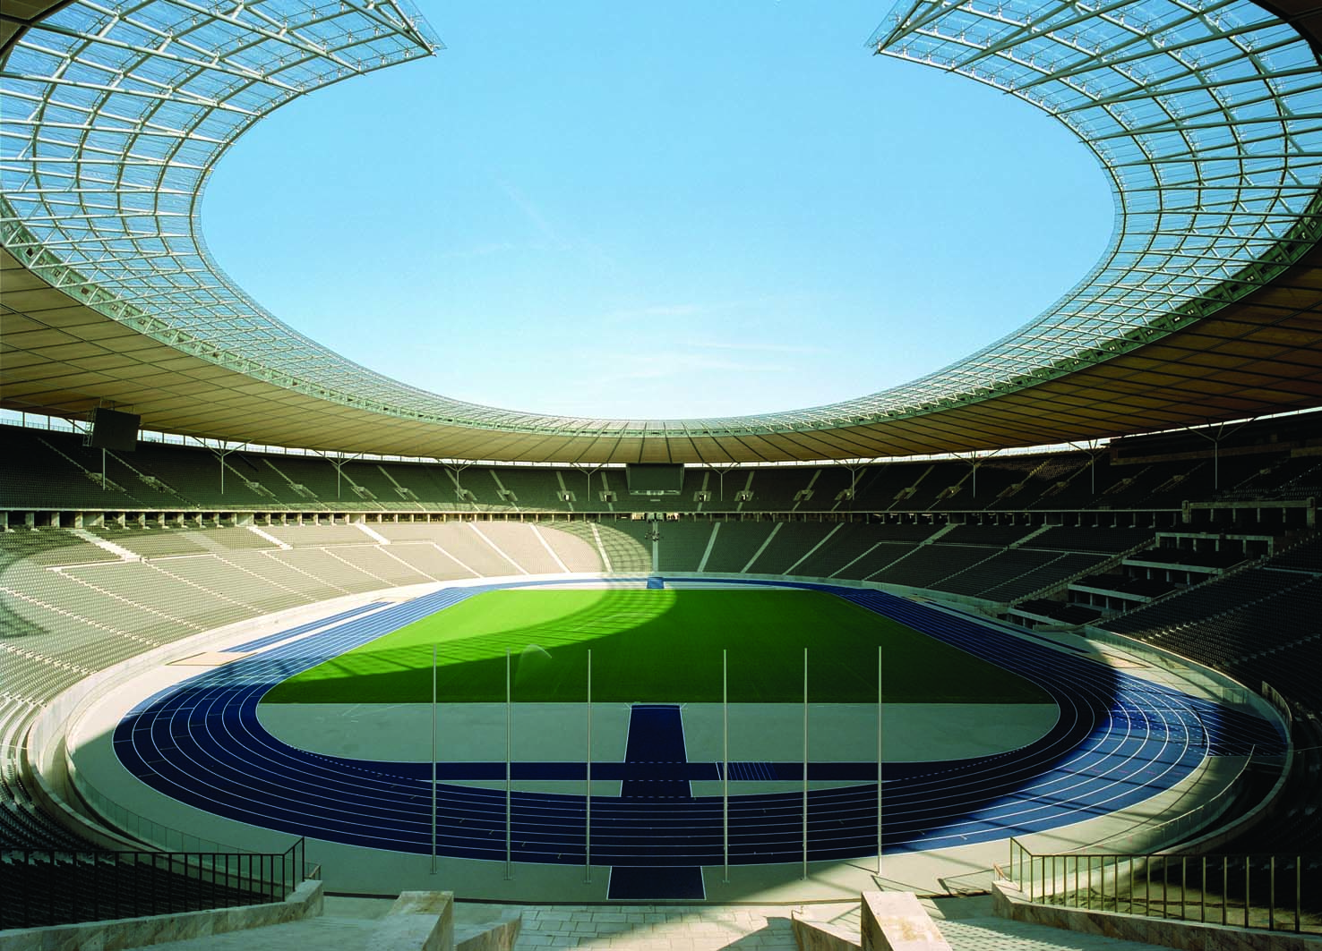
7
TOPICS FOR FURTHER STUDY

Slide 2
21
The Theory of Consumer Choice

Slide 3
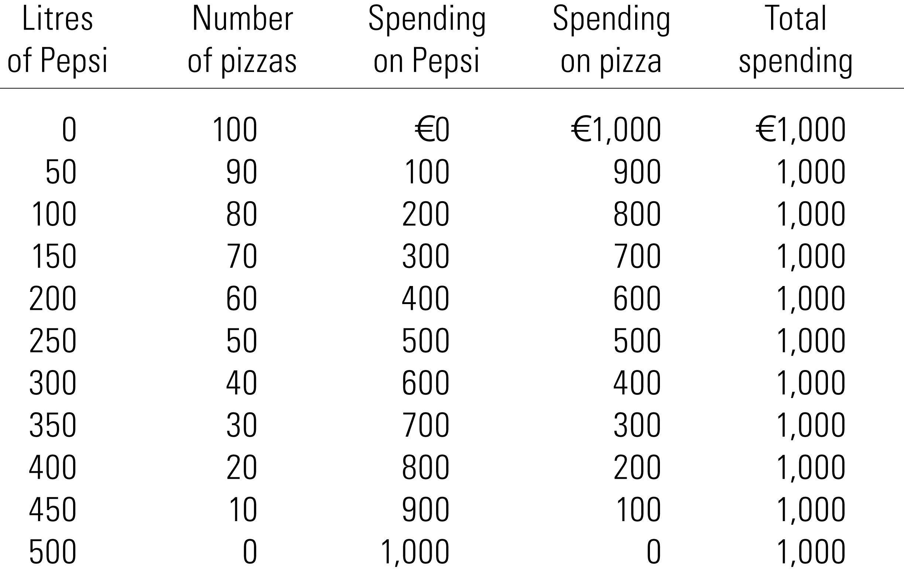
The Consumer’s Budget Constraint

Slide 4

Figure 1 The Consumer’s Budget Constraint
Quantity
of Pepsi
B
500
Consumer’s
budget constraint
A
0
100
Quantity
of Pizza
Copyright©2004 South-Western

Slide 5
Figure 1 The Consumer’s Budget Constraint
Quantity
of Pepsi
B
500
C
250
Consumer’s
budget constraint
A
0
50
100
Quantity
of Pizza
Copyright©2004 South-Western

Slide 6
Figure 2 The Consumer’s Preferences
Quantity
of Pepsi
C
B
D
I₂
Indifference
A
curve,
I₁
0
Quantity
of Pizza
Copyright©2004 South-Western

Slide 7
Figure 2 The Consumer’s Preferences
Quantity
of Pepsi
C
B
D
MRS
I₂
1
Indifference
A
curve,
I₁
0
Quantity
of Pizza
Copyright©2004 South-Western

Slide 8
Figure 2 The Consumer’s Preferences
Quantity
of Pepsi
C
B
D
I₂
Indifference
A
curve,
I₁
0
Quantity
of Pizza
Copyright©2004 South-Western

Slide 9
Figure 2 The Consumer’s Preferences
Quantity
of Pepsi
Indifference
curve,
I₁
0
Quantity
of Pizza
Copyright©2004 South-Western

Slide 10
Figure 3 The Impossibility of Intersecting Indifference Curves
Quantity
of Pepsi
C
A
B
0
Quantity
of Pizza
Copyright©2004 South-Western

Slide 11
Figure 4 Bowed Indifference Curves
Quantity
of Pepsi
14
MRS
= 6
8
A
1
4
MRS
= 1
B
3
1
Indifference
curve
0
2
3
6
7
Quantity
of Pizza
Copyright©2004 South-Western

Slide 12
Figure 5 Perfect Substitutes and Perfect Complements
(a) Perfect Substitutes
10p coins
15
10
5
I₁
I₂
I₃
0
1
2
3
50p coins
Copyright©2004 South-Western

Slide 13
Figure 5 Perfect Substitutes and Perfect Complements
(b) Perfect Complements
Left
Shoes
I₂
7
5
I₁
0
5
7
Right Shoes
Copyright©2004 South-Western

Slide 14
Figure 6 The Consumer’s Optimum
Quantity
of Pepsi
Optimum
B
A
I₃
I₂
I₁
Budget constraint
0
Quantity
of Pizza
Copyright©2004 South-Western

Slide 15
Figure 7 An Increase in Income
Quantity
of Pepsi
New budget constraint
1. An increase in income shifts the
budget constraint outward . . .
New optimum
3. . . . and
Pepsi
Initial
consumption.
optimum
I₂
Initial
budget
I₁
constraint
0
Quantity
2. . . . raising pizza consumption . . .
of Pizza
Copyright©2004 South-Western

Slide 16
Figure 8 An Inferior Good
Quantity
of Pepsi
New budget constraint
1. When an increase in income shifts the
3. . . . but
Initial
budget constraint outward . . .
Pepsi
optimum
consumption
falls, making
New optimum
Pepsi an
inferior good.
Initial
budget
I₁
I₂
constraint
0
Quantity
2. . . . pizza consumption rises, making pizza a normal good . . .
of Pizza
Copyright©2004 South-Western

Slide 17
Figure 9 A Change in Price
Quantity
of Pepsi
1,000
D
New budget constraint
New optimum
500
B
1. A fall in the price of Pepsi rotates
the budget constraint outward . . .
3. . . . and
raising Pepsi
Initial optimum
consumption.
Initial
I₂
budget
I₁
constraint
A
0
100
Quantity
2. . . . reducing pizza consumption . . .
of Pizza
Copyright©2004 South-Western

Slide 18
Figure 10 Income and Substitution Effects
Quantity
of Pepsi
New budget constraint
C
New optimum
Income
effect
B
Initial optimum
Substitution
Initial
effect
budget
constraint
A
I₂
I₁
0
Quantity
Substitution effect
of Pizza
Income effect
Copyright©2004 South-Western

Slide 19

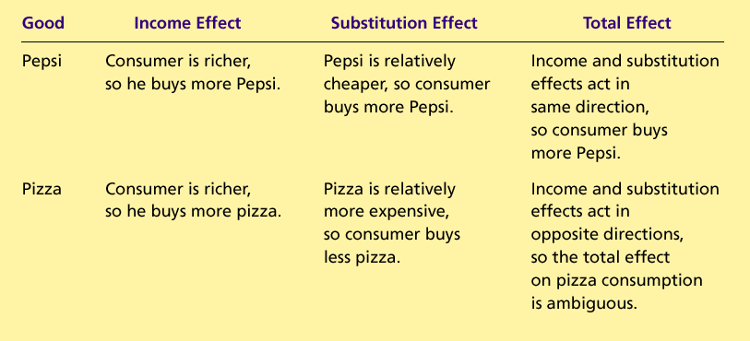
Table 1 Income and Substitution Effects When the Price of Pepsi Falls
Copyright©2004 South-Western

Slide 20
Figure 11 Deriving the Demand Curve
(a) The Consumer
’
s Optimum
(b) The Demand Curve for Pepsi
Quantity
Price of
of Pepsi
New budget constraint
Pepsi
750
B
$2
A
I₂
B
A
1
250
Demand
I₁
0
Initial budget
Quantity
0
250
750
Quantity
constraint
of Pizza
of Pepsi
Copyright©2004 South-Western

Slide 21
Figure 12 A Giffen Good
Quantity of
Potatoes
Initial budget constraint
B
Optimum with high
price of potatoes
Optimum with low
D
price of potatoes
2. . . . which
E
1. An increase in the price of
increases
C
potatoes rotates the budget
potato
constraint inward . . .
consumption
if potatoes
I₁
are a Giffen
New budget
I₂
good.
constraint
0
A
Quantity
of Meat
Copyright©2004 South-Western

Slide 22
Figure 13 The Work-Leisure Decision
Consumption
€ 5,000
Optimum
I₃
2,000
I₂
I₁
0
60
100
Hours of Leisure
Copyright©2004 South-Western

Slide 23
Figure 14 An Increase in the Wage
(a) For a person with these preferences
. . .
. . . the labor supply curve slopes upward.
Consumption
Wage
Labor
supply
1. When the wage rises . . .
BC₁
BC₂
I₂
I₁
0
Hours of
0
Hours of Labor
2. . . . hours of leisure decrease . . .
Leisure
3. . . . and hours of labor increase.
Supplied
Copyright©2004 South-Western

Slide 24
Figure 14 An Increase in the Wage
(b) For a person with these preferences
. . .
. . .
the labor supply curve slopes backward.
Consumption
Wage
BC₂
1. When the wage rises . . .
Labor
BC₁
supply
I₂
I₁
0
Hours of
0
Hours of Labor
2. . . . hours of leisure increase . . .
Leisure
3. . . . and hours of labor decrease.
Supplied
Copyright©2004 South-Western

Slide 25
Figure 15 The Consumption-Saving Decision
Consumption
Budget
when Old
constraint
€ 110,000
55,000
Optimum
I₃
I₂
I₁
0
€ 50,000
100,000
Consumption
when Young
Copyright©2004 South-Western

Slide 26
Figure 16 An Increase in the Interest Rate
(a) Higher Interest Rate Raises Saving
(b) Higher Interest Rate Lowers Saving
Consumption
Consumption
when Old
BC₂
when Old
BC₂
1. A higher interest rate rotates
1. A higher interest rate rotates
the budget constraint outward . . .
the budget constraint outward . . .
BC₁
BC₁
I₂
I₁
I₂
I₁
0
Consumption
0
Consumption
2. . . . resulting in lower
when Young
2. . . . resulting in higher
when Young
consumption when young
consumption when young
and, thus, higher saving.
and, thus, lower saving.
Copyright©2004 South-Western

